Slide 1

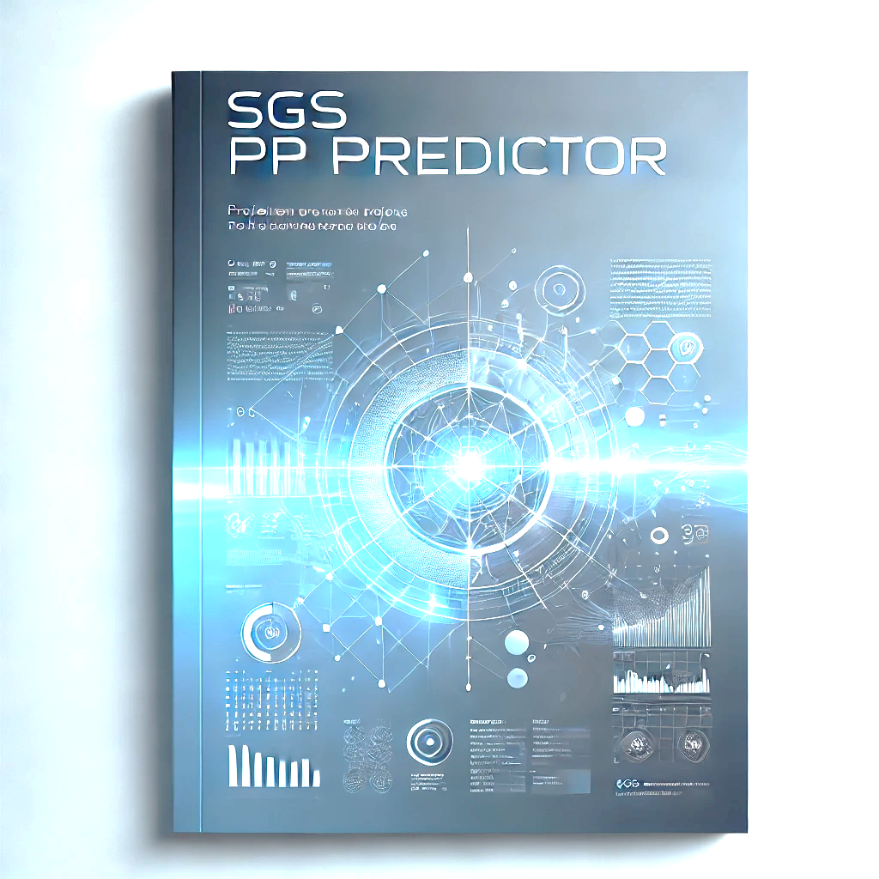
ARUNKUMAR .K

Slide 2


01
02
Agenda
03
04
How it starts
Idea origination
Idea
Core idea behind PP predictor
Data & Benefits
Benefits with data summary
Prototype
Real – time project simulation
Current state vs Future state
05
MySGS workflow for Prepress

Slide 3





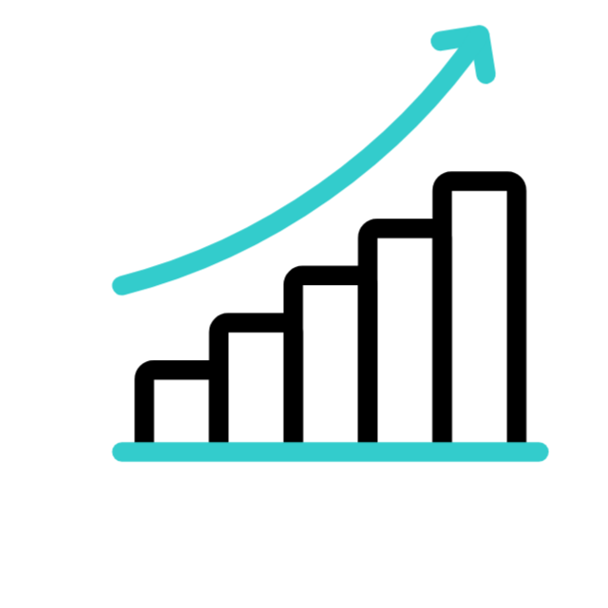


How it starts
Capacity overrun
Timely delivery
Only for few tasks
Pending complex tasks
Remove unnecessary tasks
Identify Leakage
Unnecessary tasks

Slide 4

What is Pre-press predictor and how it works
The PP Predictor is an AI-powered machine learning model that uses advanced NLP(Natural language process) and ML(Machine Learning) algorithms to analyze PM brief instructions and predict if a task can be bypassed. It extracts key information, identifies job requirements, and suggests tasks for optimization or removal. Integrated with tools like Auto Trap Task and one Cycle Workflow, it further enhances operational efficiency.
Less than 3/col jobs & Digital PP jobs
For jobs involving less than 3/col, our dedicated auto trap workflow can handle most of the trapping tasks, which greatly reduces the need for Prepress operator involvement.
While the digital printing process typically does not require prepress tasks, Digital-PP work has still been assigned to the operator in some cases.
An AI-powered machine learning model could be implemented to efficiently bypass unnecessary prepress tasks by analyzing and understanding the PM's brief instructions.

Slide 5



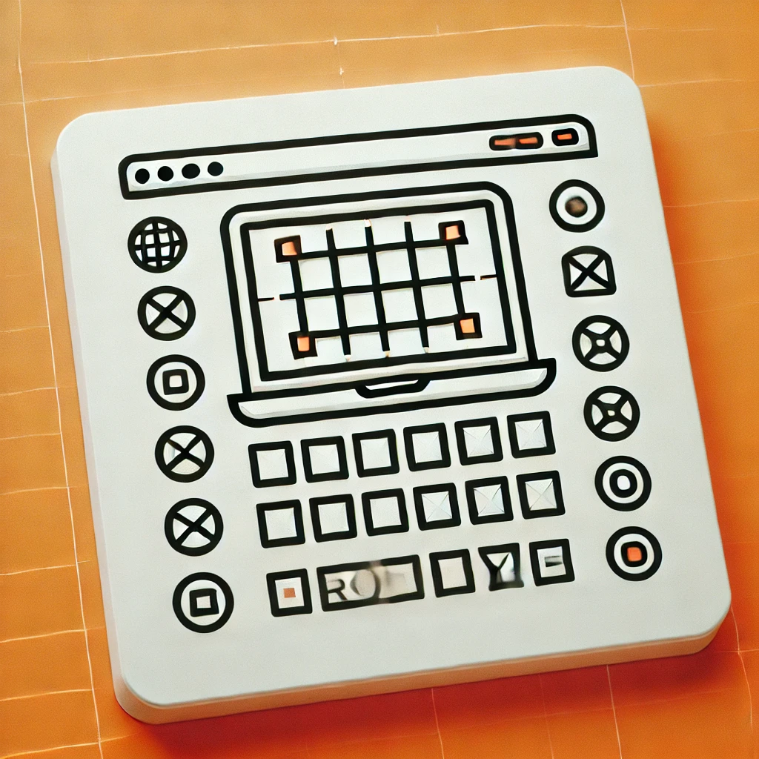

IDENTIFY
DEFINE
IDEATE
PROTOTYPE
TEST
Design thinking principle
Using AI (Machine learning model)
Sample brief instruction
Fewer than 3/Col tasks & Digital PP tasks
Bypass the tasks
MySGS Simulation

Slide 6
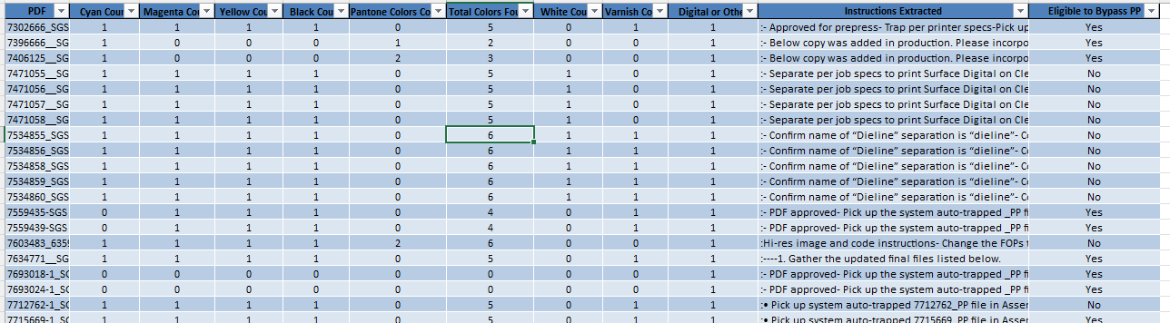
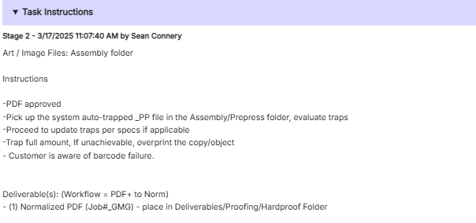

AI Brief –Training
The AI-powered machine learning model is trained on 500+ brief instructions, enabling it to analyze and interpret the PM's brief to identify and eliminate unnecessary prepress tasks.

Slide 7
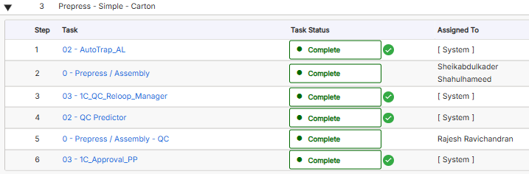
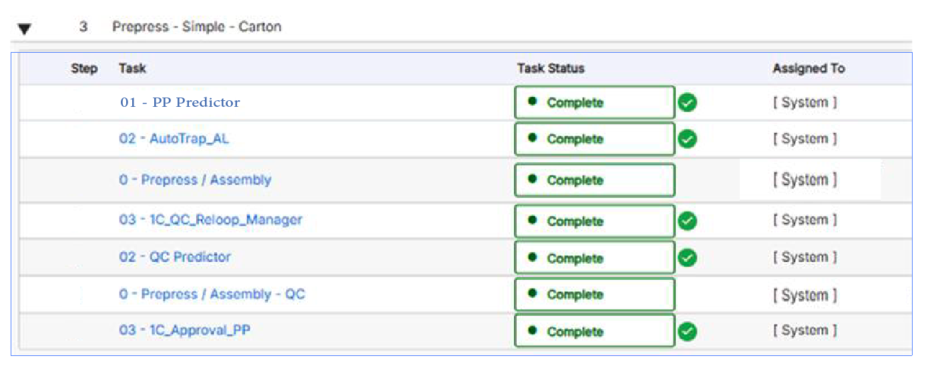
Current state vs Future state
Current State
Task to be added
Future State

Slide 8
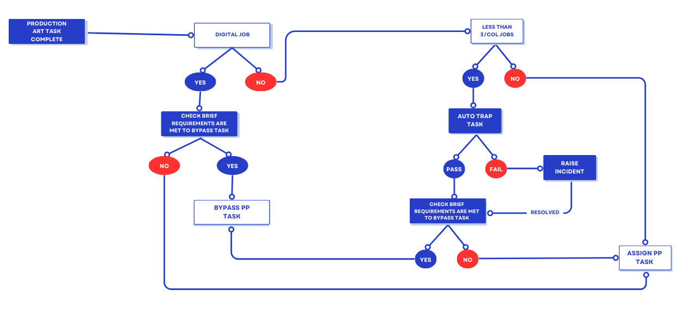
Prepress predictor process

Slide 9
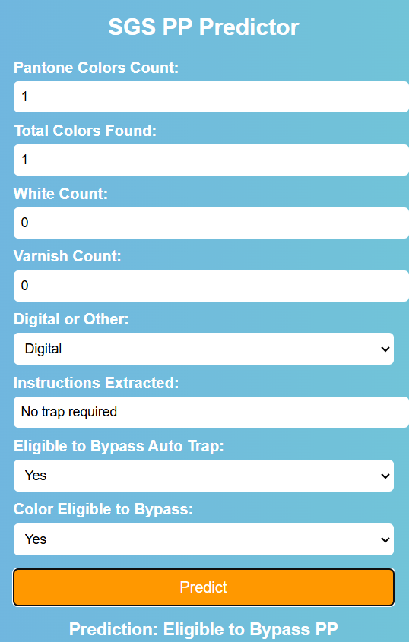
Prototype
"A simulation demonstrating how the AI model functions in the background using code, with its operations remaining invisible to the user or operator."
Colors Fetch from MySGS
Print process details Fetch from MySGS
Brief details Fetch from MySGS
Auto trap bypass check based on number of colors
Color eligibility check based on number of colors
Final Result

Slide 10
Benefits –PP predictor
Less than 3/col jobs: By implementing a machine learning model to bypass prepress tasks for jobs with fewer than three colors, we can save approximately 3 PP and 1 QC resources for North America accounts with a headcount of 120. When scaled to the entire studio, which has over 357(243 PP & 114 QC) production staff, this solution could result in a potential savings of around 8 PP and 3 QC resources.
Digital-PP Optimization: By leveraging the ML model, we can seamlessly automate digital Prepress tasks, reducing manual dependency on the PM. Alternatively, the PM can be notified to assign Prepress tasks only when necessary. This optimization streamlines operations and leads to a savings of approximately 3 PP and 1 QC resources across the studio, driving efficient resource management.

Slide 11





Benefits - Item cycle time
Job booking
Production Hours
QC Hours
Delivery
~ 45min – 60 min saving per task

Slide 12
Q&A

